Slide 1
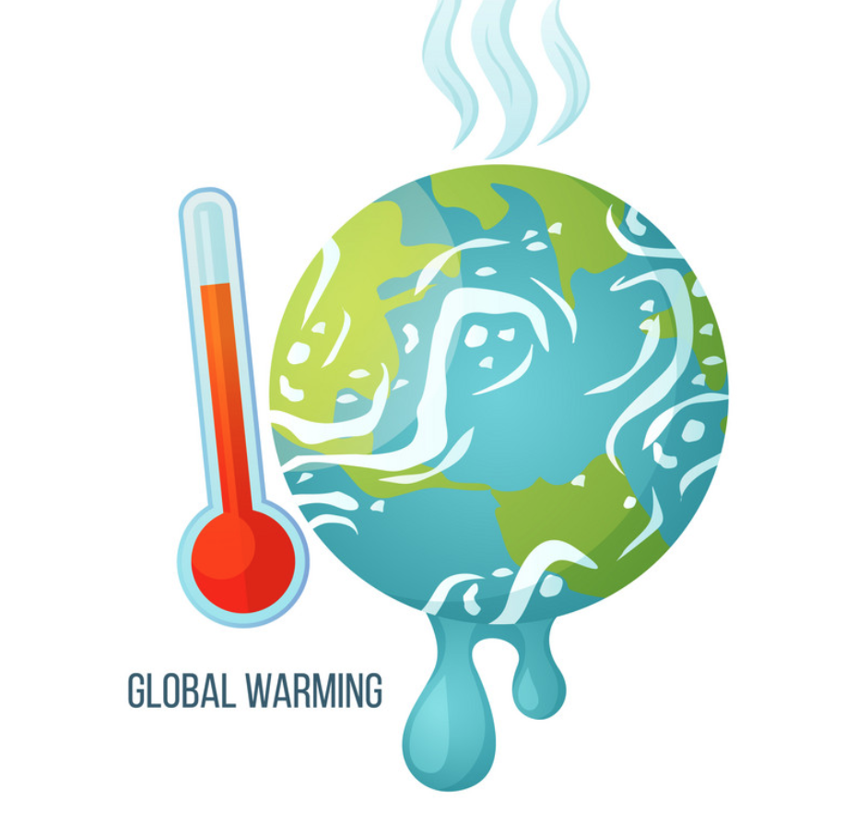
When Will The 1.5°C Threshold Be Reached and Surpassed?
By: Alex Liu

Slide 2
What is the 1.5°C Limit?
The IPCC (Intergovernmental Panel on Climate Change) states that an 1.5°C increase in global average temperature from pre-industrial times will lead to a start in climate catastrophes
Examples include extreme heatwaves, rising ocean levels, destruction of 70-90% of coral reef population, etc.
1.5°C is the control threshold that should not be exceeded

Slide 3
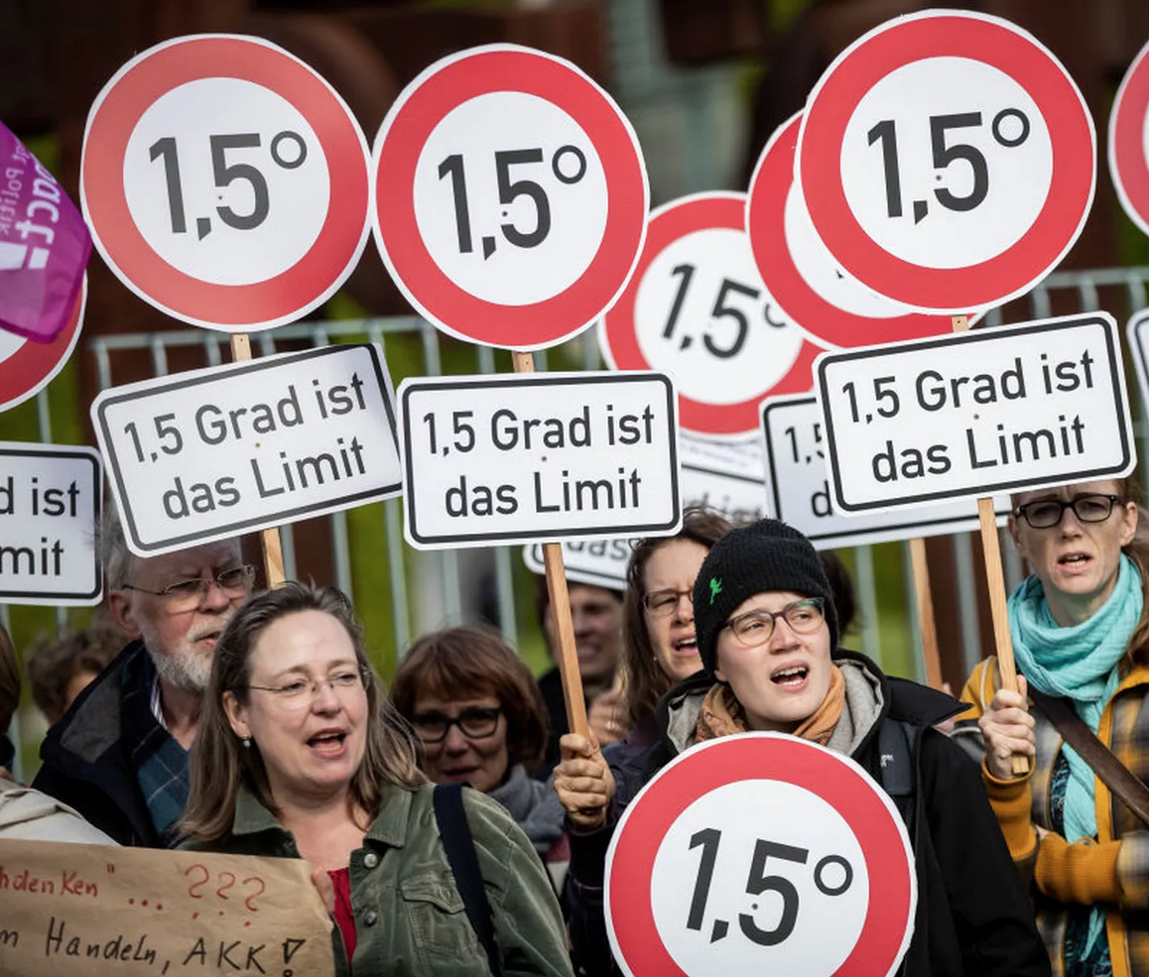
The Problem:
Approaching the 1.5°C danger line for global warming
The 2015 Paris Agreement urges countries to contribute in limiting global average temperature rise to under 1.5°C
When will the 1.5°C threshold be reached under current circumstances?

Slide 4
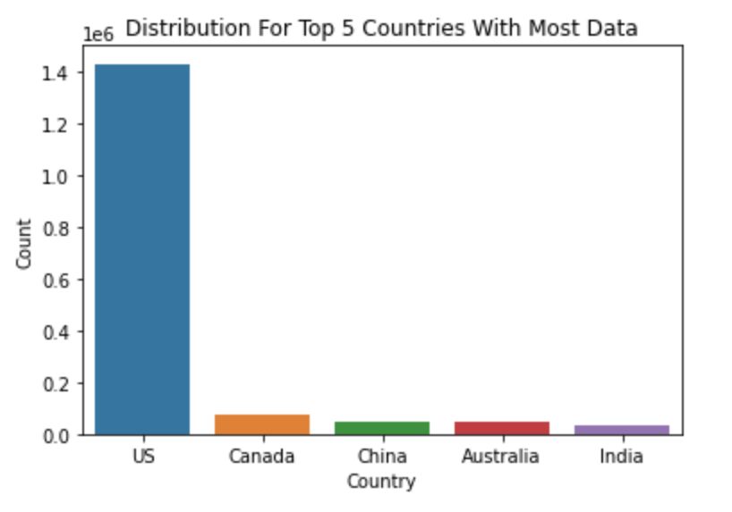
Dataset Information
Average temperature ranging from January 1995 to December 2019
Locations are based on 321 major cities from 125 countries
Data distribution skewed towards North America
Approximately 2.9 million rows of data

Slide 5
How To Measure Increase in Average Global Temperature?
Temperature anomaly method:
Anomaly = Actual temperature – reference temperature
Commonly used method (i.e. NASA) to calculate global average temperature
Set reference temperature as earliest as possible (1995 average monthly temperatures) to best represent pre-industrial times

Slide 6
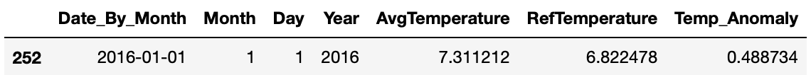
Anomaly Calculation Example (for 2016):
Anomaly = Actual temperature – reference temperature
Anomaly (Jan 2016) = Jan 2016 Temp – Jan 1995 Temp
Anomaly (Jan 2016) = 7.311212 – 6.822478 = 0.488734

Slide 7
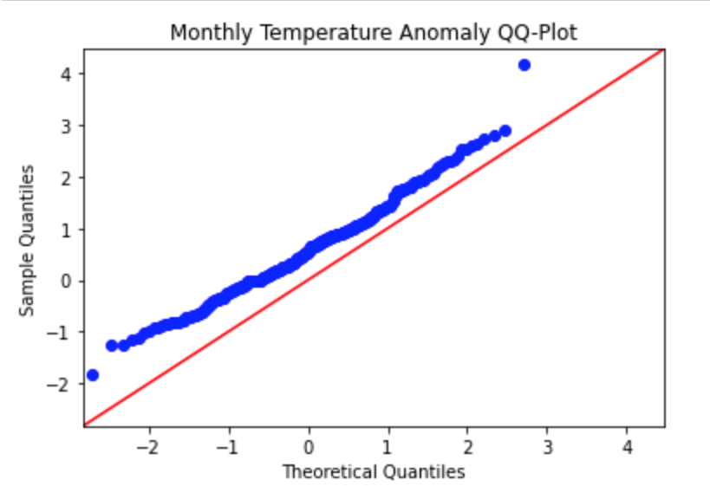
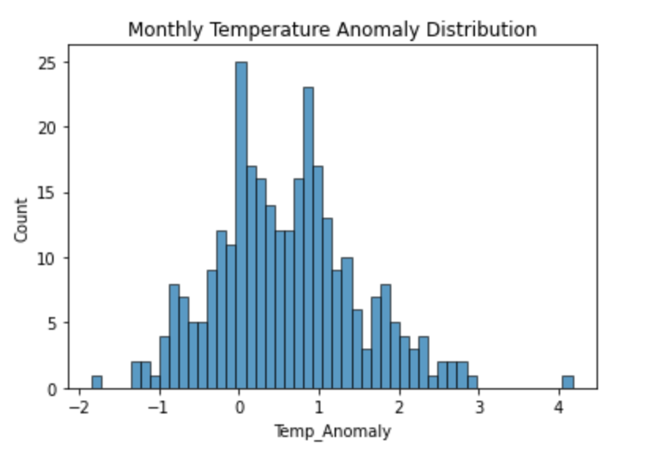
Monthly Anomaly Data is Normally Distributed!

Slide 8
Modelling

Slide 9
Model Selection
ARIMA model, order=(p, d, q) where 0 <= p, d, q <= 2
RMSE, MAPE, MAE to be used for evaluation metrics

Slide 10
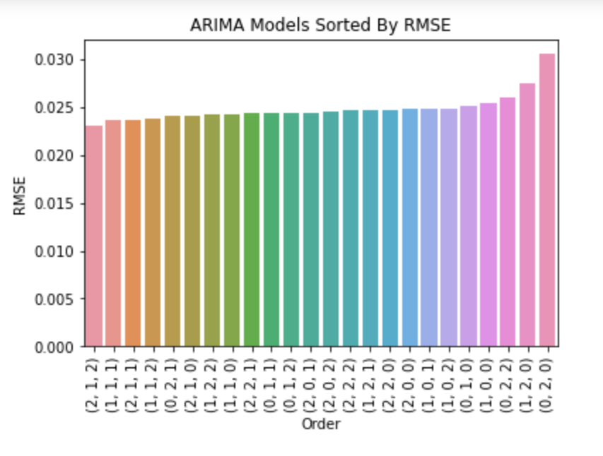
ARIMA(2,1,2) is the best model by RMSE as it produces the least error!

Slide 11
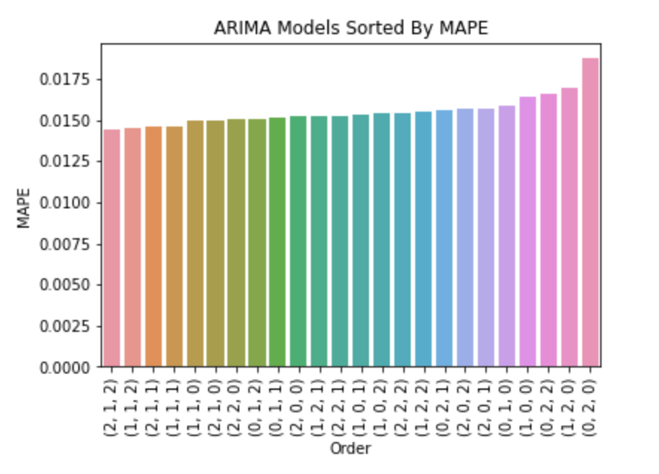
ARIMA(2,1,2) is the best model by MAPE as it produces the least error!

Slide 12
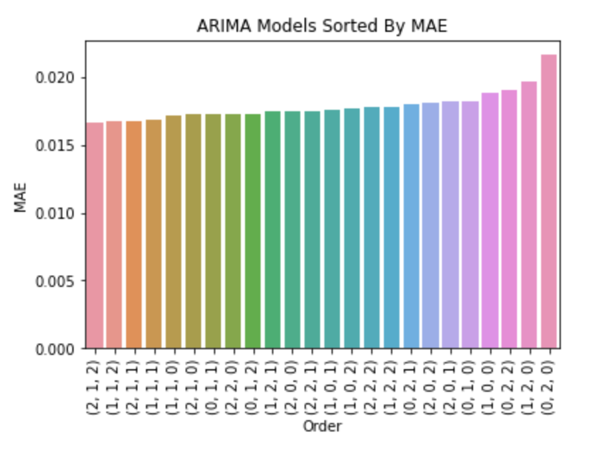
ARIMA(2,1,2) is the best model by MAE as it produces the least error! ARIMA(2,1,2) is the best model for all three evaluation metrics!

Slide 13
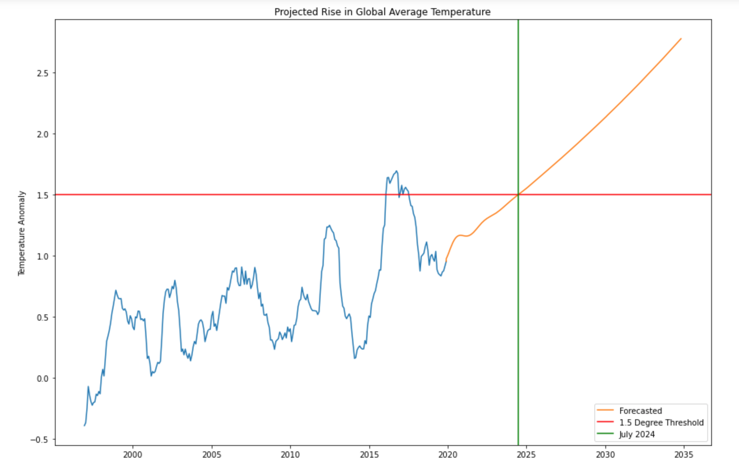
Forecasting with Best ARIMA Model (2,1,2): 1.5 threshold reached/exceeded by July 2024!

Slide 14
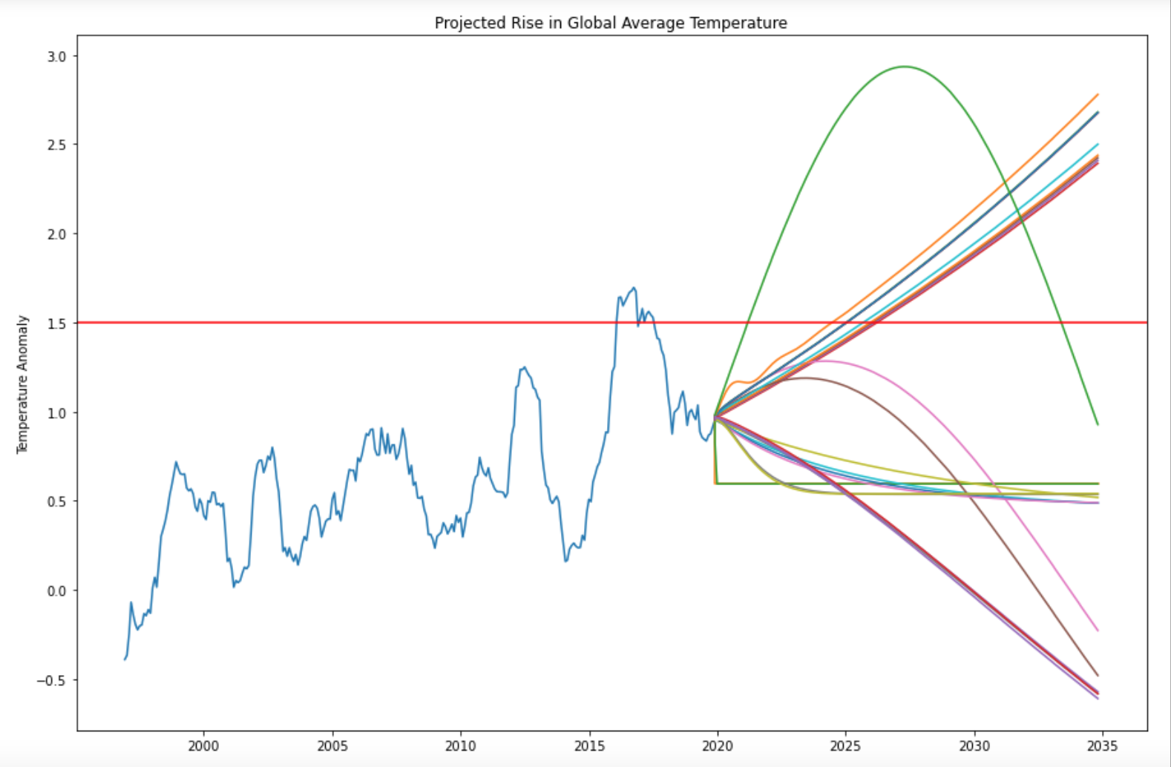
Visualize All ARIMA Models Forecasting: 3 Different Patterns!

Slide 15
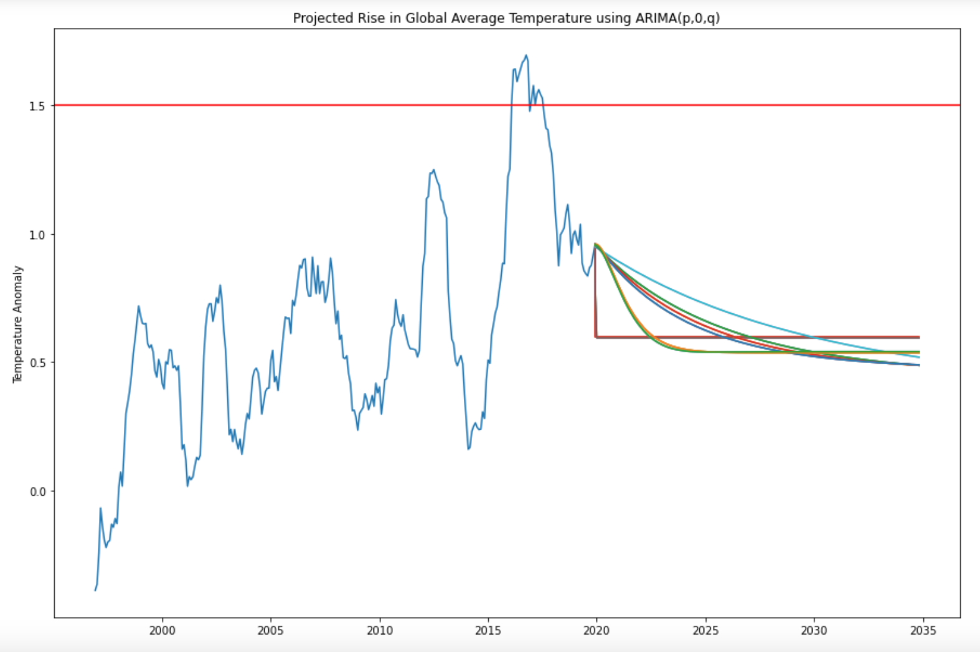
ARIMA(p,0,q): Trend doesn’t make sense given real life context!

Slide 16
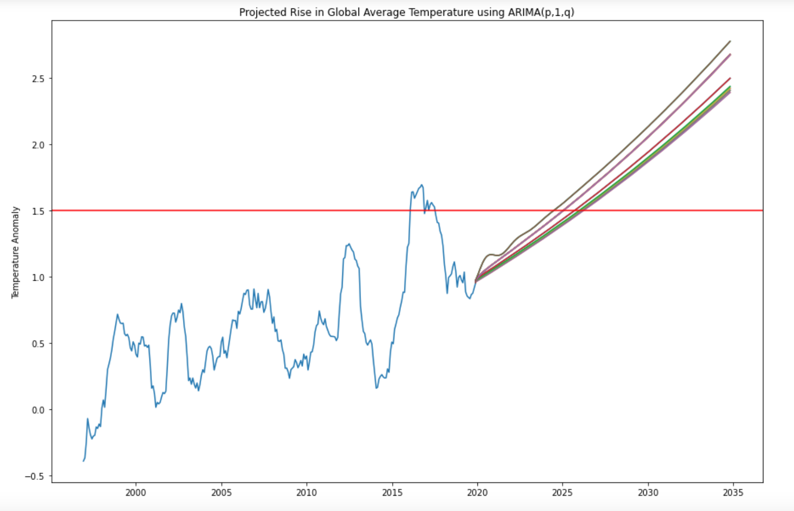
ARIMA(p,1,q): Corresponds with real life predictions short term! Exponential increase could be a problem long term!

Slide 17
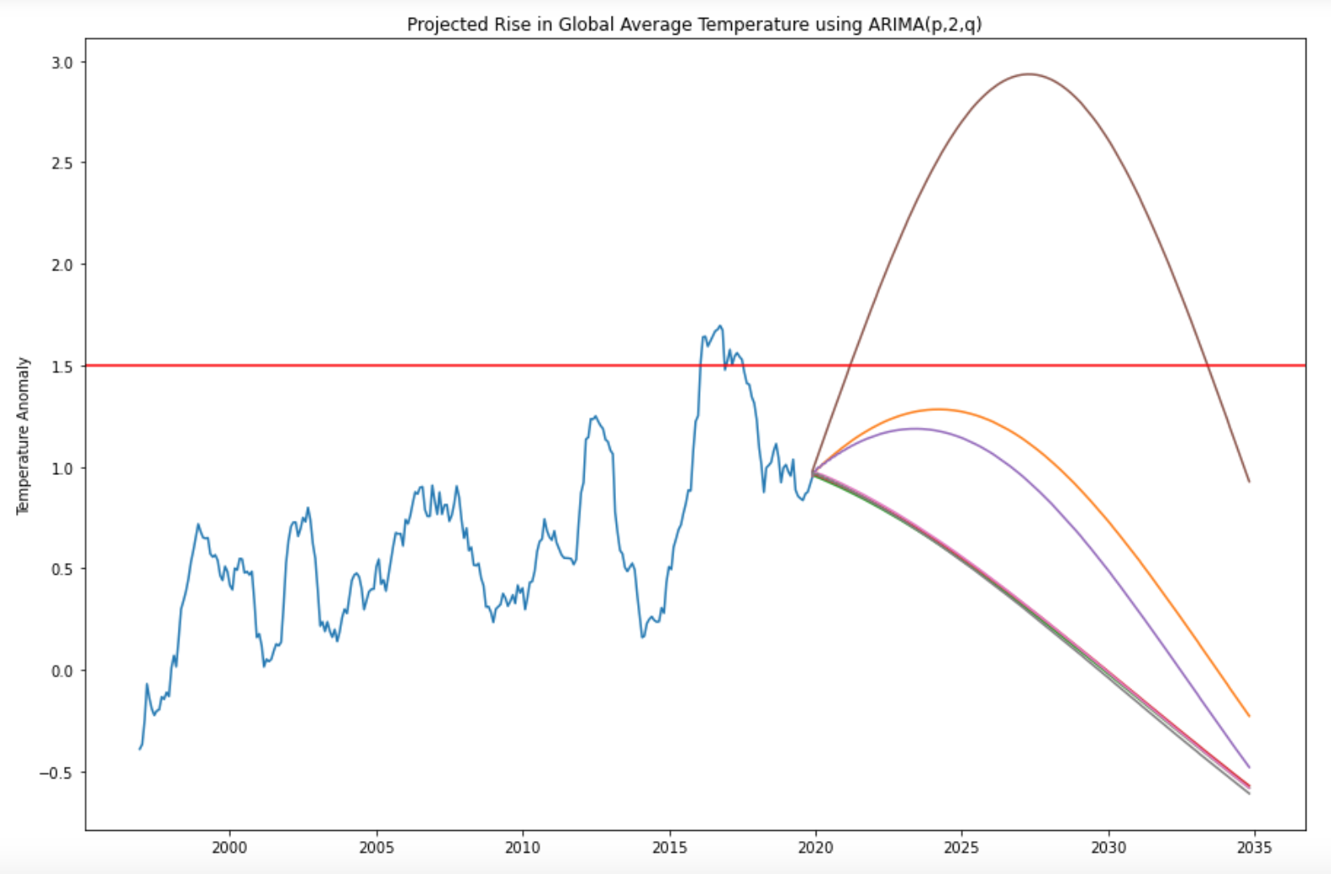
ARIMA(p,2,q): Corresponds to an ice age scenario! Pattern makes sense long term! Not so much short term!

Slide 18
ARIMA(p,1,q) Could Represent the Beginning of Ice Age Scenario

Slide 19
Main Takeaways & Future Improvements
Forecasted results are earlier than the IPCC’s predictions
Current dataset is missing a lot of locations for a complete representation of global average temperature
Consider other methods for measuring increase in global average temperature (e.g. weighted mean surface temperature anomaly method used by NASA)
Global warming is not a distant threat. 1.5 threshold will inevitably be exceeded if no action is taken

Slide 20
Thank You!

Slide 21
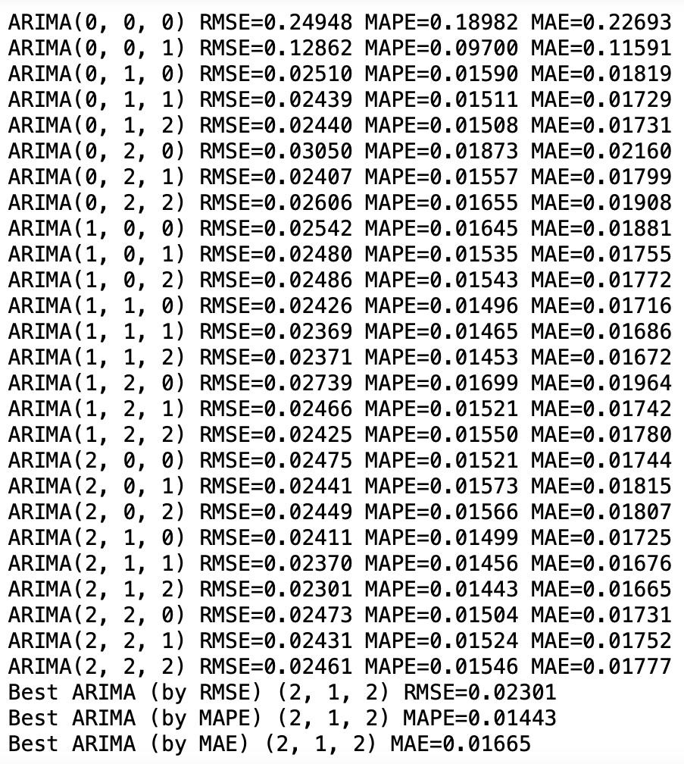
Appendix A: Evaluation Metrics Algorithm Visualized

Slide 22
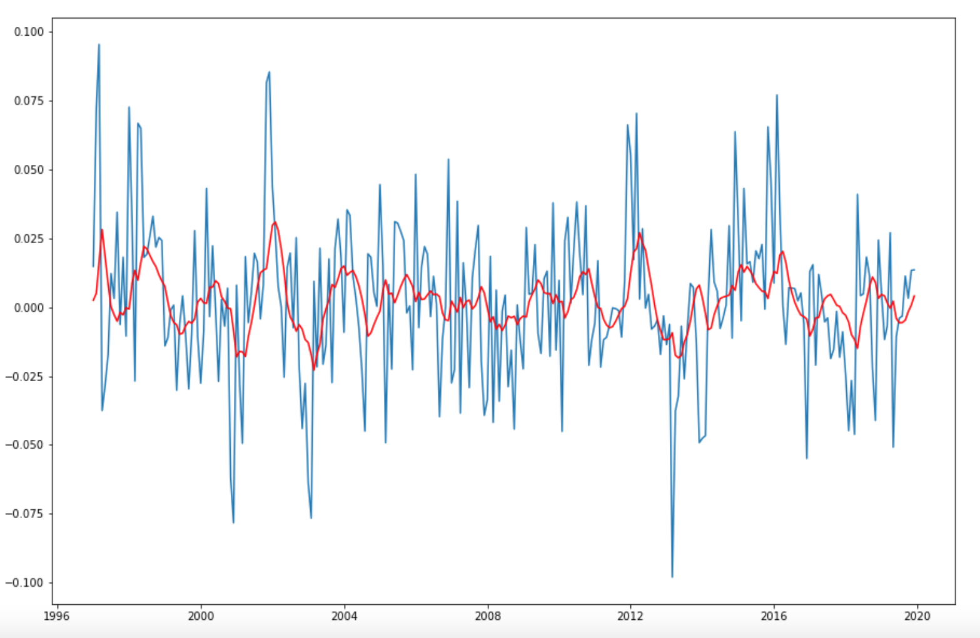
Appendix B: ARIMA(2,1,2) Model Fit Compared to Original

